Slide 1
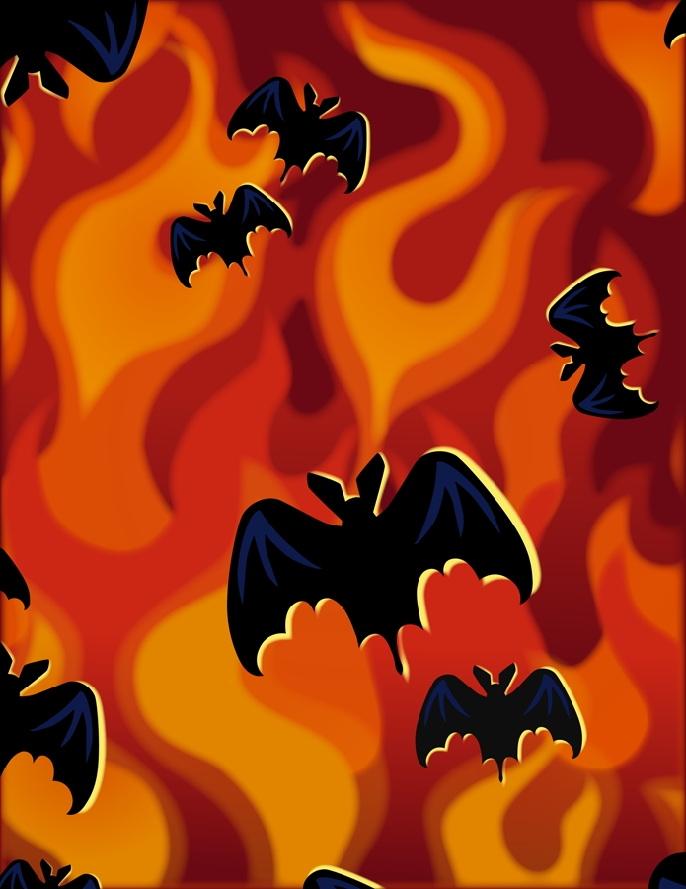
Bat Trivia
Little brown bats are the most common bats in the United States and Canada. How many night-flying insects can one bat eat in a night?
A. 100 B. 800 C. 1200 D 3000

Slide 2
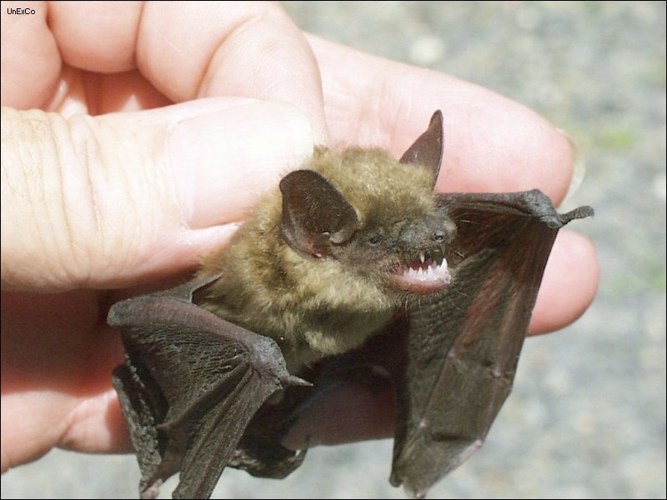
ANSWER
C. 1200

Slide 3
Bat Trivia
Created by Tamar Smirl 2010

Slide 4
BAT TRIVIA
2. Which of the following is TRUE?
A. Bats are blind.
B. Bats drink blood and eat insects.
C. Bats have lived on Earth for at least 50 million years.

Slide 5
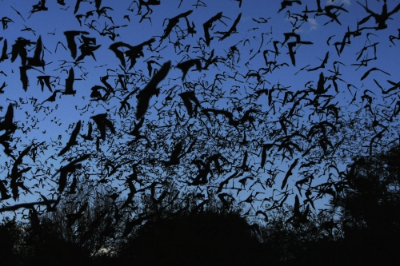
ANSWER
C. Bats have lived on Earth for at least 50 million years.

Slide 6
BAT TRIVIA
3. How long is the wingspan of the largest bat, the flying foxes of Asia?
A. 3 feet
B. 6 feet
C. 10 feet

Slide 7
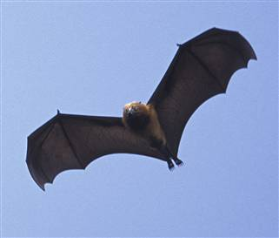
ANSWER
B. 6 feet

Slide 8
BAT TRIVIA
4. Mexican free-tailed bats are some of the fastest bats in the world. How fast can they fly?
A. 30 mph
B. 60 mph
C. 90 mph

Slide 9
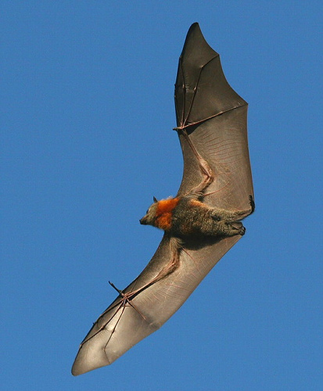
ANSWER
B. 60 mph

Slide 10
BAT TRIVIA
5. How many “fingers” are found on a bat’s wing?
A. 2 B. 3 C. 5 D. None

Slide 11
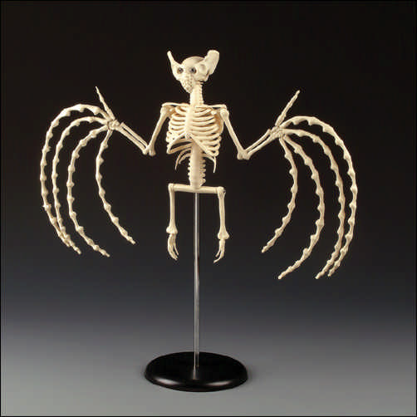
ANSWER
C. 5

