Slide 1
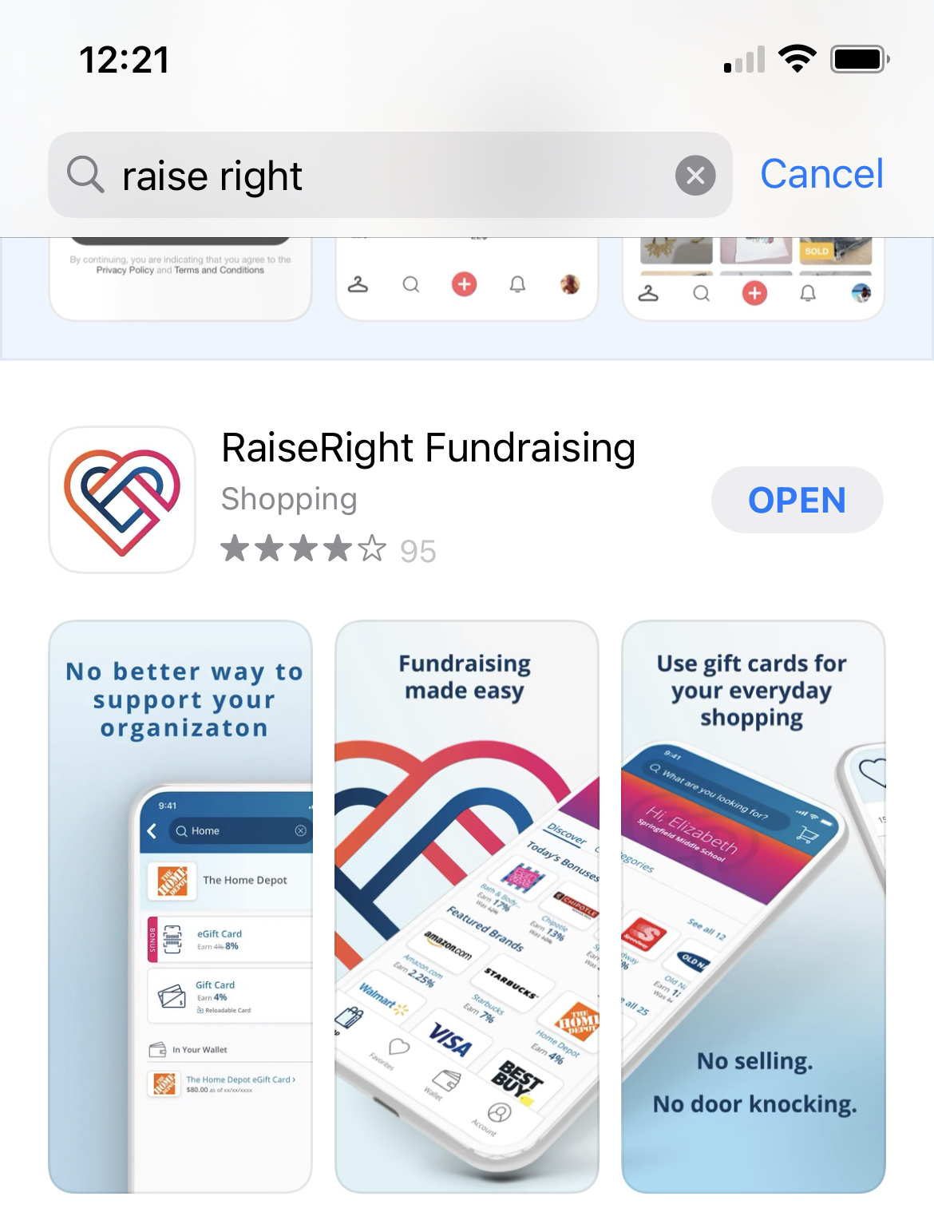
SI eGift Card Program
Join
• Download the RaiseRight app.
• Enter Code: 3886D5C59L18

Slide 2
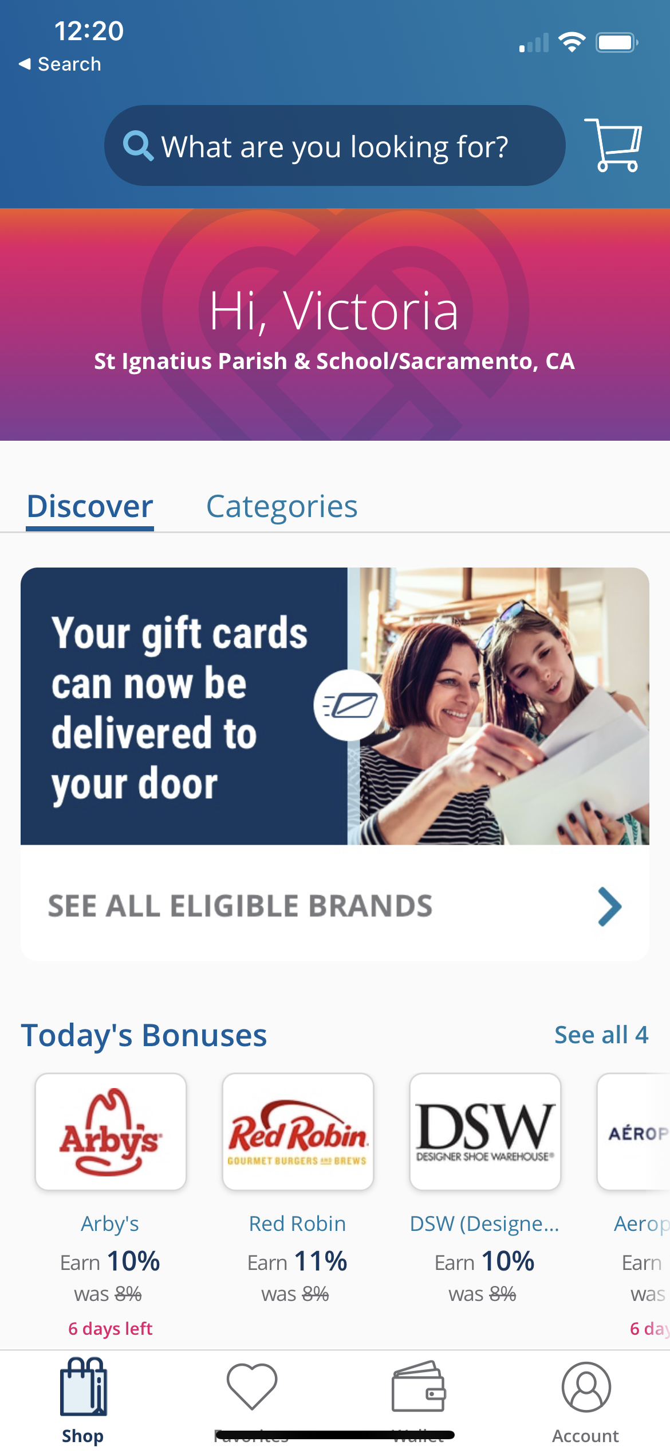
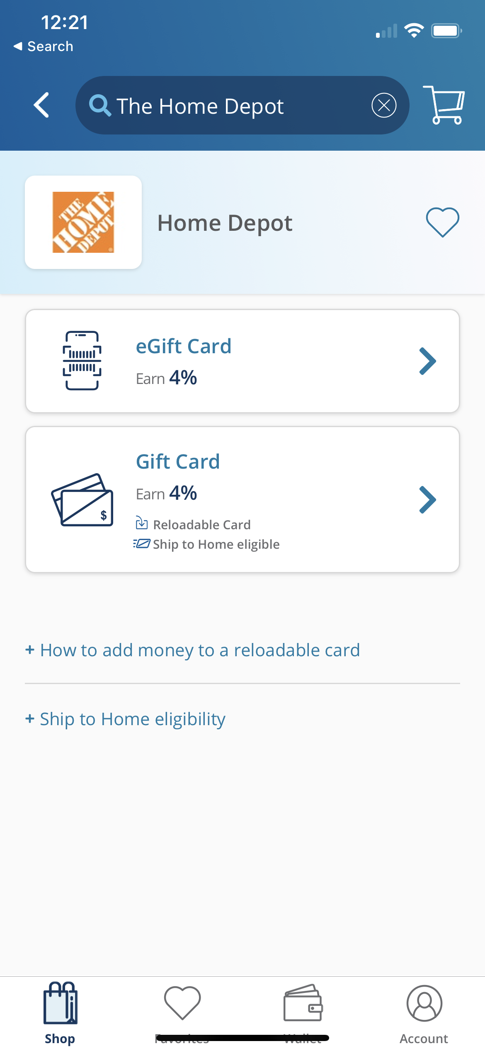
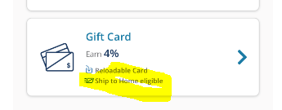
SI eGift Card Program
Start Shopping and Earn for SI:
• Any Gift Card with an eGift Card Option is available to purchase
• Some Physical Gift Cards are eligible to be Shipped to your Home and will list if that option is available
Please Note: SI is not processing orders to be shipped to the school

Slide 3
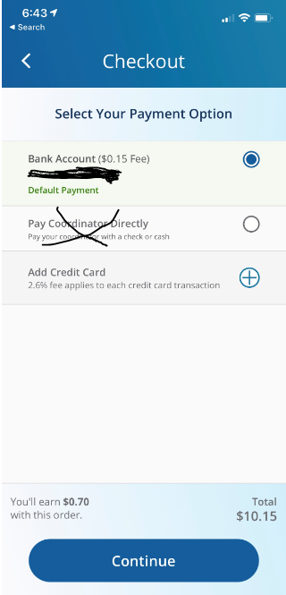
SI eGift Card Program
Pay for eGift Cards and Earn:
• Directly from your bank account (all transactions have a $.15 fee)
or
• Using a Credit card (all transactions have a 2.6% fee)
Please Note: SI is not processing orders via the pay coordinator directly
Please note: Participation in this program is voluntary as there are no Parent Club gift card purchasing requirements. Families will not earn any credit towards Parent Club Fundraising requirements by participating in the program, BUT you will raise money for the school for your purchases.

Slide 4
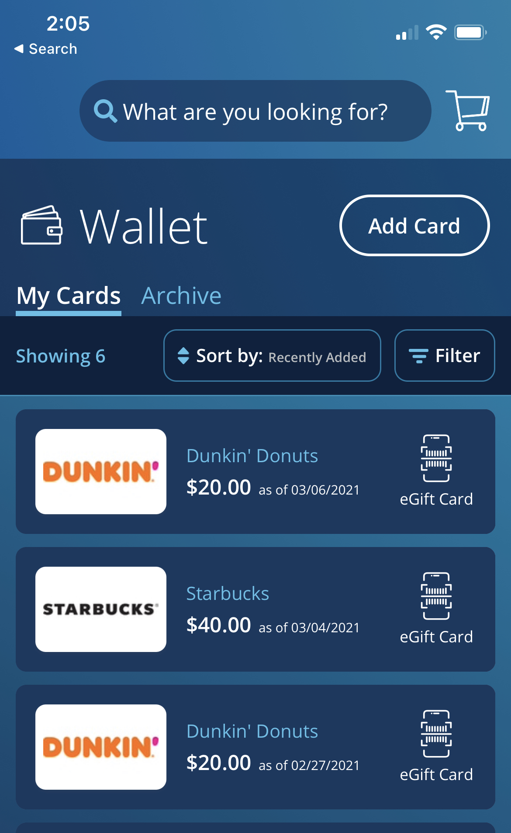
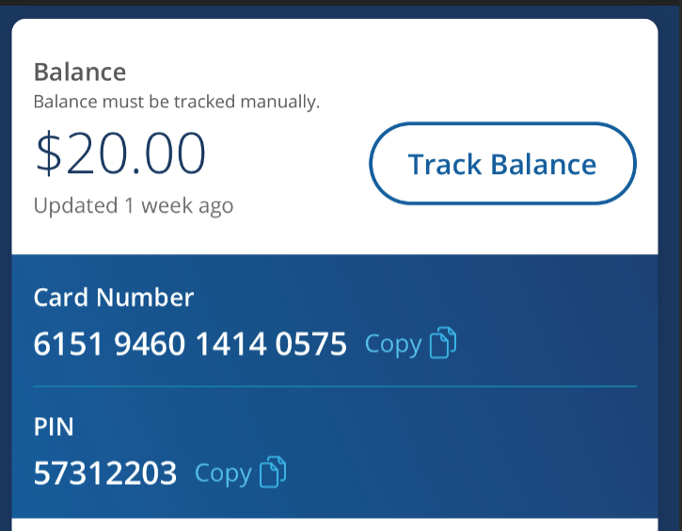
SI eGift Card Program
Start Using your eGift Cards in the store

